Slide 1
Fire Code Issues Facing Fire Chiefs
Anthony Apfelbeck
Fire Marshal/Building Official
City of Altamonte Springs
Central Florida Fire Chiefs
November 12, 2009

Slide 2
Objectives
Statutory Authority and Responsibility
Local Fire Code Amendments
Venue Shift in Code Development
Manual Fire Alarm System Retrofit
Truss Marking
One-and Two-Family Dwelling Fire Sprinklers
Customer Service

Slide 3
Statutory Authority and Responsibility
633.121 Persons authorized to enforce laws and rules of State Fire Marshal.--The chiefs of county, municipal, and special-district fire departments; other fire department personnel designated by their respective chiefs; and personnel designated by local governments having no organized fire departments are authorized to enforce this law and all rules prescribed by the State Fire Marshal within their respective jurisdictions.

Slide 4
Statutory Authority and Responsibility
SFMO DEC Statement Casselberry 39751-01
  The local fire official must not be subject to, or under the control of, the local building official in matters involving firesafety inspections;
  The local building official is not permitted to overrule the local fire official in matters involving firesafety inspections (Nothing in this Declaratory Statement is intended to mean that the local fire official may not be subject to the local building official for strictly administrative or time-management purposes. . .)

Slide 5
Statutory Authority and Responsibility
Why is this important?
  Increased emphasis on merging fire prevention and building departments
  The fire inspector license is relatively easy to obtain
  The building official license is impossible to obtain for most fire prevention staff
Therefore, placing fire under building is usually the solution that results in greatest economies
Be prepared to respond to this option

Slide 6
Local Fire Code Amendments
547 Adopting Agencies in Florida
  67 Counties
  69 Special Fire Control Districts
  411 Cities
Only 42 Legal Fire Code Amendments
  6 Counties <9%
  6 Special Districts <9%
  30 Cities <8%

Slide 7
Local Fire Code Amendments
Guidelines:
  1. If your technical amendment to the Florida Fire Prevention Code is not listed on the SFMO web site, it is not a legal fire code amendment.
  2. Just because your local amendment is posted, it does not mean it is legal.
  3. Most local amendments sunset every three years with the new code.
  4. Adoption of a local amendment has numerous qualifiers listed in 633.0215 , .022 and .025.
  5. Do not rely on your legal counsel!!

Slide 8
Venue Shift in Code Development
The Florida Fire Prevention Code is developed in two areas:
  1. National: As NFPA 1- Fire Code and NFPA 101-Life Safety Code.
  2. State: As amendments to NFPA 1 and 101.
Difficult to amend locally and the SFMO is reluctant to amend on a state basis
Easiest to change the base documents of NFPA-1 and 101

Slide 9
Venue Shift in Code Development
Example: Liability Issue
  New Text in NFPA 1 Section 1.9.2 2009 Edition of NFPA
  “The fire department and AHJ, acting in good faith and without malice in the discharge of the organizations’ public duty, shall not thereby be rendered liable for any damage that could accrue to persons or property as a result of any act or by reason of any act or omission in the discharge of such duties.”

Slide 10
Venue Shift in Code Development
Ability to Amend the Code Locally is Very Limited, Therefore:
Request Demand that your Fire Marshal get involved on a State and National level:
  Submit Code Change to NFPA or ICC
  Attend or Provide Comments on State Rule Development Hearings
  Participate in Grass Roots Lobbying with your State Senators and Representatives

Slide 11
Manual Fire Alarm Retrofit
Fire Code Requires:
  Existing apartment buildings more than 11 dwelling units shall be provided with a manual fire alarm system.
    Includes condominiums
    High dollar issue, most complexes are $200,000+
    Lots of political pressure from condos
    Exemption vetoed last legislative session for two story or less with direct exit to the outside
    Expect to see this issue again this next legislative session

Slide 12
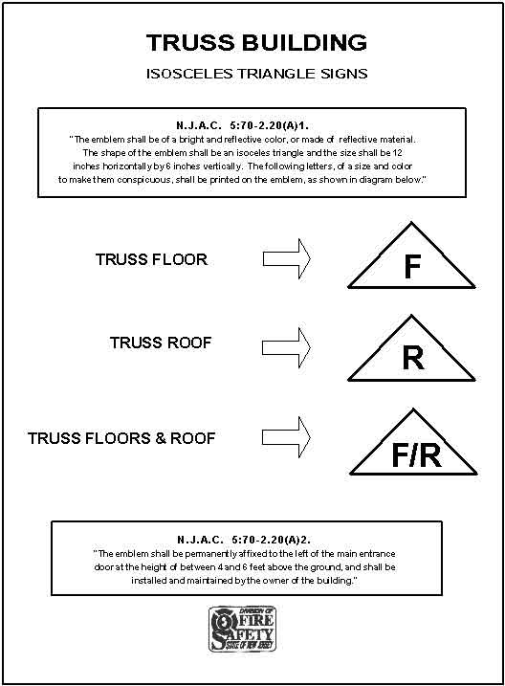
Truss Marking

Slide 13
Truss Marking
633.027 Buildings with light-frame truss-type construction; notice requirements; enforcement.--
(1) The owner of any commercial or industrial structure, or any multiunit residential structure of three units or more, that uses light-frame truss-type construction shall mark the structure with a sign or symbol approved by the State Fire Marshal in a manner sufficient to warn persons conducting fire control and other emergency operations of the existence of light-frame truss-type construction in the structure.
(2) The State Fire Marshal shall adopt rules necessary to implement the provisions of this section, including, but not limited to:
(a) The dimensions and color of such sign or symbol.
(b) The time within which commercial, industrial, and multiunit residential structures that use light-frame truss-type construction shall be marked as required by this section.
(c) The location on each commercial, industrial, and multiunit residential structure that uses light-frame truss-type construction where such sign or symbol must be posted.
(3) The State Fire Marshal, and local fire officials in accordance with s. 633.121, shall enforce the provisions of this section. Any owner who fails to comply with the requirements of this section is subject to penalties as provided in s. 633.161.

Slide 14
Truss Marking
Still in Rule Development 18 Months After Passage, in JAPC and may have to be reissued.
Questions:
  1. What is “light-frame truss type construction?”
  2. Does it include bar-joist?
  3. If it does, 99% of the structures in Altamonte will be marked. So, what did we accomplish?
  4. Where do you mark?
    Covered mall building, Big Box
  5. Failure to mark creates an false feeling of safety to responding units

Slide 15
Truss Marking
8” X 8” Red in Color with 24” of the Main Entrance Door

Slide 16
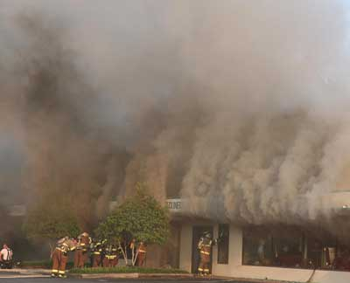
Truss Marking
Charleston NIOSH Report Recommendation

Slide 17
Truss Marking
“Fire departments should develop, implement and enforce written SOPs and provide fire fighters with training on the hazards of truss construction”
  “Fire departments should use defensive strategies whenever trusses have been exposed to fire or structural integrity cannot be verified. Unless life-saving operations are under way, fire fighters should immediately be evacuated and an exterior attack should be used. Fire fighters performing fire-fighting operations under or above trusses should be evacuated as soon as it is determined that the trusses are exposed to fire (not according to a time limit).”

Slide 18

One-and Two-Family Dwelling Fire Sprinklers
Civilian Deaths
  78% of all structure fires occur in residential properties
  84% of civilian fire deaths occur in the home
  Fire Sprinklers reduce the civilian death rate by at least 63% in SFD, in reality, it is 90%+

Slide 19
One-and Two-Family Dwelling Fire Sprinklers
Firefighter Deaths
  1997-2006 250 Firefighters killed in structure fires
    246 killed in non-sprinklered buildings
    4 were killed in buildings protected by an operational fire sprinkler system
    1 non-sprinklered attic fire
    3 explosion at a pesticide plant
If we are truly serious about firefighter safety, we need to be serious about sprinklers in one-and two-family dwellings!

Slide 20


Slide 21
One-and Two-Family Dwelling Fire Sprinklers
Fire sprinklers in one-and two family dwellings are now required in both national codes: NFPA and ICC
Reaffirmed at the last ICC code hearing 7-4 vote by the committee and over 90% of the floor membership
Two challenges in Florida
  Legislative-Florida Home Builders Association
  Florida Building Commission
We must step up to the challenge in Florida!

Slide 22
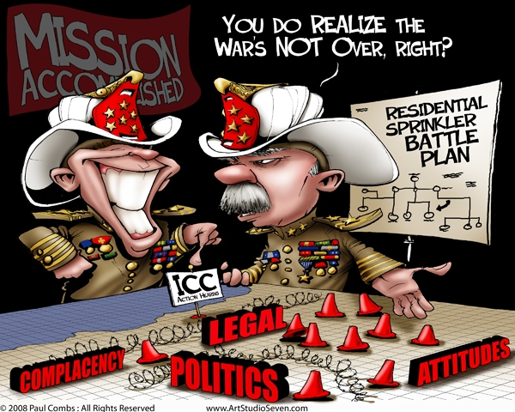

Slide 23
Customer Service
#1 issue – Almost NEVER technical
  Contractors don’t really care how much they pay in fees as long as they get quality service
    Turn Around Time
      Plans- Less than 10 business days
      Inspections- Next business day
  Economic Recovery
    Internal Staffing
    Contract Work?
  Online Permitting
  Don’t be afraid to ask questions. Remember, you are the Chief Fire Official!

Slide 24
Recommendation
1. Ask your Fire Marshal to take an active role in the state and national code development processes.
2. Make it a priority to defend the SFD sprinkler provision.
3. Review your local amendments for compliance with the statutory provisions.
4. Read the Charleston NIOSH report.
5. Develop specific customer service benchmarks for your fire prevention bureau that are measurable and accountable.

Slide 25
Questions?
Cell Phone: 407-832-7800
ACApfelbeck@Altamonte.org

